Slide 1

QnQ
HEALTHCARE

Slide 2

ABSTRACT
Call the healthcare center for scheduling, prescription refills, order Enquiries, and billing concerns.
In emergencies, contact the center for immediate assistance.
Receive follow-up calls after medical procedures to ensure patient well-being.
Contact calls or medical-related chats to verify the placement of orders through phone or WhatsApp.

Slide 3






AGENDA
How to Install the app
How to Sign in
How to upload Prescription
How to place the order
Menu

Slide 4
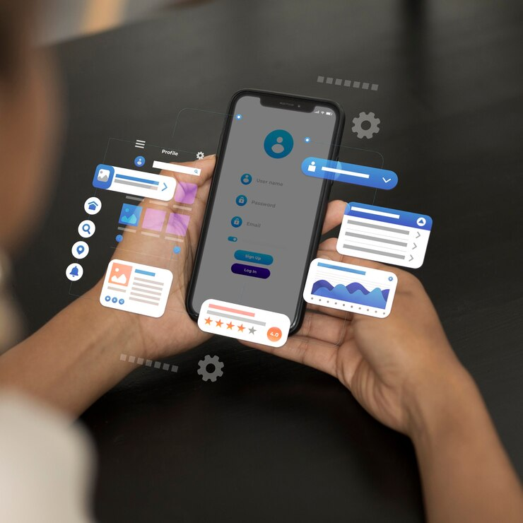
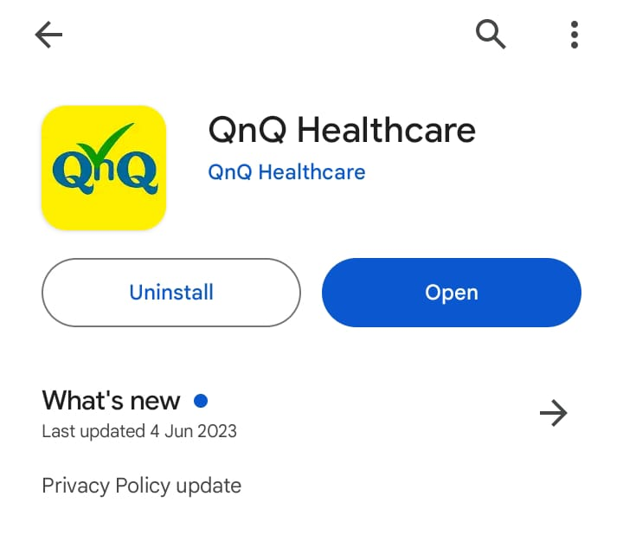
1. HOW TO INSTALL THE APP
Open the Google Play Store.
Search for "QnQ Healthcare" in the Google Play Store.
Install the app on your device.

Slide 5


1. HOW TO INSTALL THE APP
4. Access the app on your mobile or other devices after installation.

Slide 6
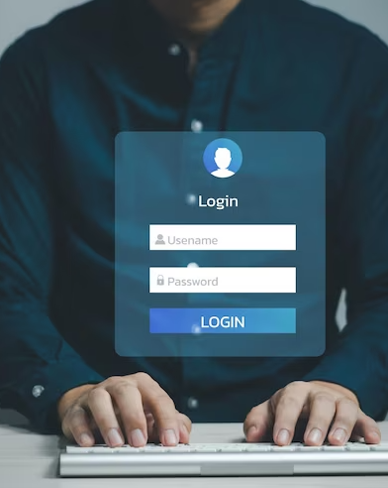
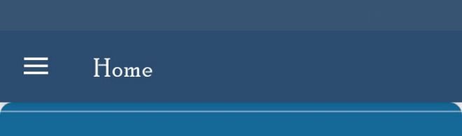
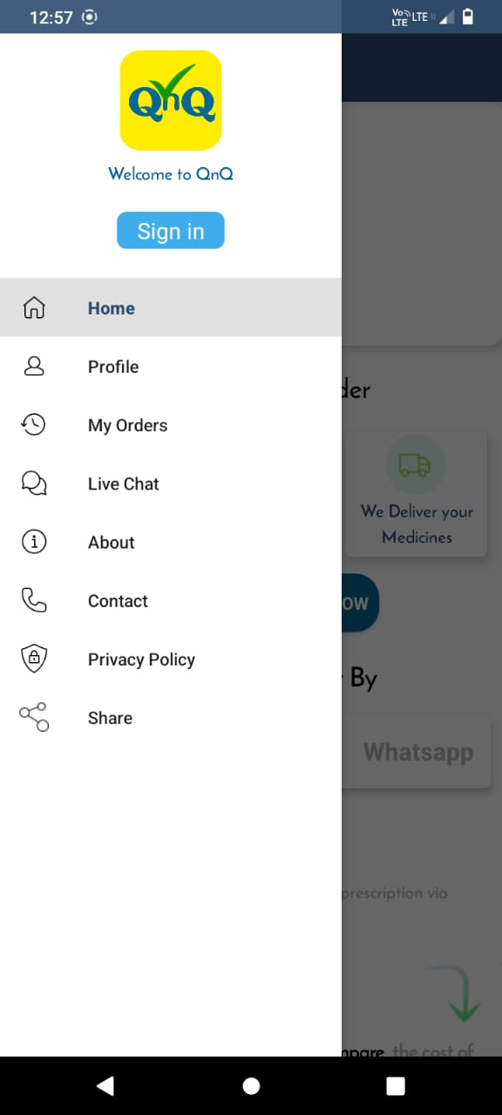
2. HOW TO SIGN-IN
1. Open the 'QNQ Healthcare' app.
2. Navigate to the menu bar.
3. Locate the 'Sign-In' button.
4. Click the 'Sign-In' button to access the sign-in panel.

Slide 7

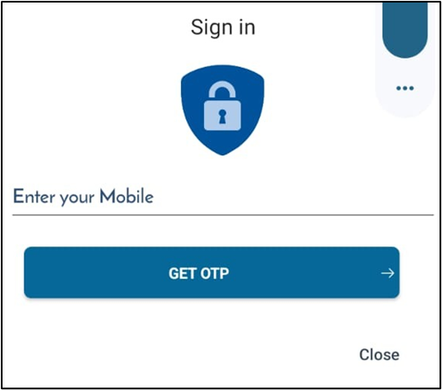
2. HOW TO SIGN-IN
5. Enter your mobile number in the provided field.
6. Send/get the OTP (One-Time Password).
7. After receiving the OTP, enter it in the designated space.
5
6 & 7

Slide 8

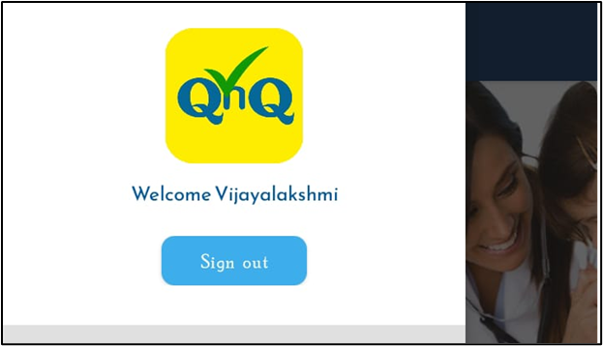
2. HOW TO SIGN-IN
8. Complete the sign-in process by successfully entering the verification code.

Slide 9

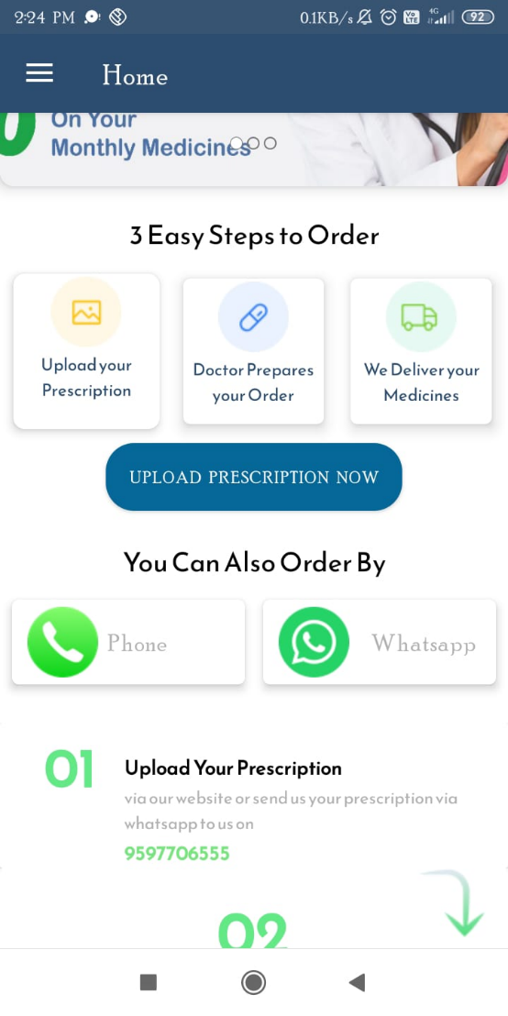
3. HOW TO UPLOAD PRESCRIPTION
1. Navigate to the 'Home' section.
2. Click on the 'Upload Prescription Now' button.

Slide 10


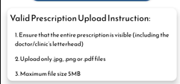
3. HOW TO UPLOAD PRESCRIPTION
3. Follow the guided process to reach the 'Prescription Upload' page.
4. Find instructions for valid prescription uploads on this page.

Slide 11

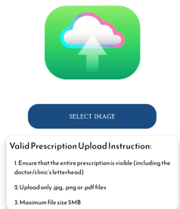
3. HOW TO UPLOAD PRESCRIPTION
5. Locate and select the 'Select Image' button above the instructions.
6. Upload the relevant prescription by following the provided guidelines.

Slide 12


3. HOW TO UPLOAD PRESCRIPTION
7. Upon completing the upload, the prescription is sent to the 'Call Center.’
8. Expect a follow-up from the proficient Call Center staff, who will contact you.

Slide 13

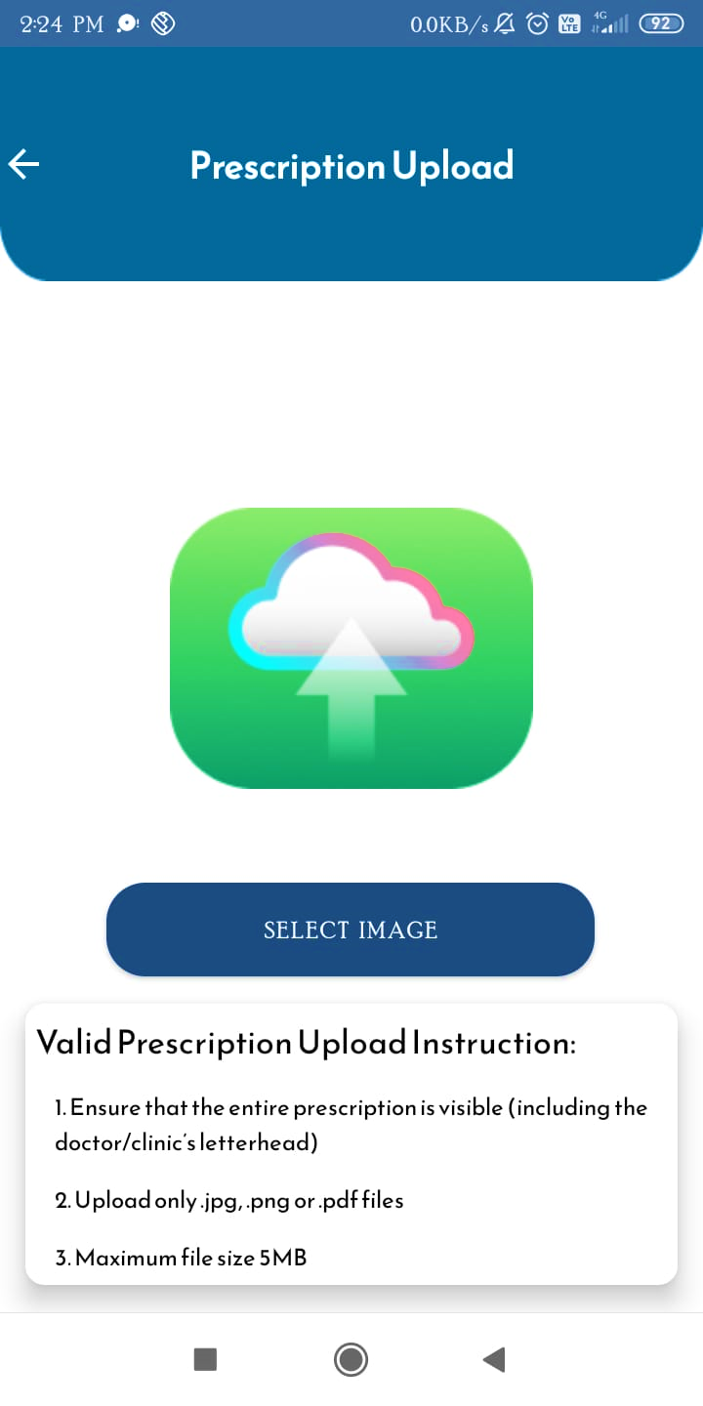
3. HOW TO UPLOAD PRESCRIPTION
3
5
4,6 & 7

Slide 14

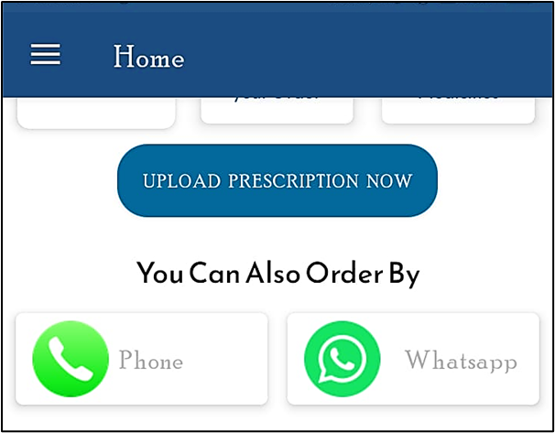
4. HOW TO PLACE THE ORDER
1. Explore three convenient ordering options.
2. Navigate to the 'Home' section.
3. Identify two primary methods for placing orders.

Slide 15



4. HOW TO PLACE THE ORDER
4. Choose the first method by calling the 'Call Center' to submit your order.
5. Alternatively, Choose the second method by clicking on the WhatsApp option.
6. Follow the link directly to the 'Call Center' WhatsApp chat page.
7. Within the chat and Call, proceed to place your order.

Slide 16

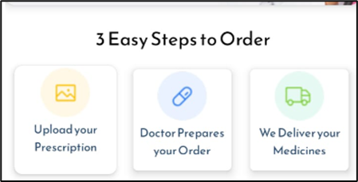
4. HOW TO PLACE THE ORDER
8. The instructions to place the order are displayed below the 'icons.’
9. It displays medicine comparison, doctor prescriptions, and medicine delivery status; these processes are managed in the "Call Centre."

Slide 17
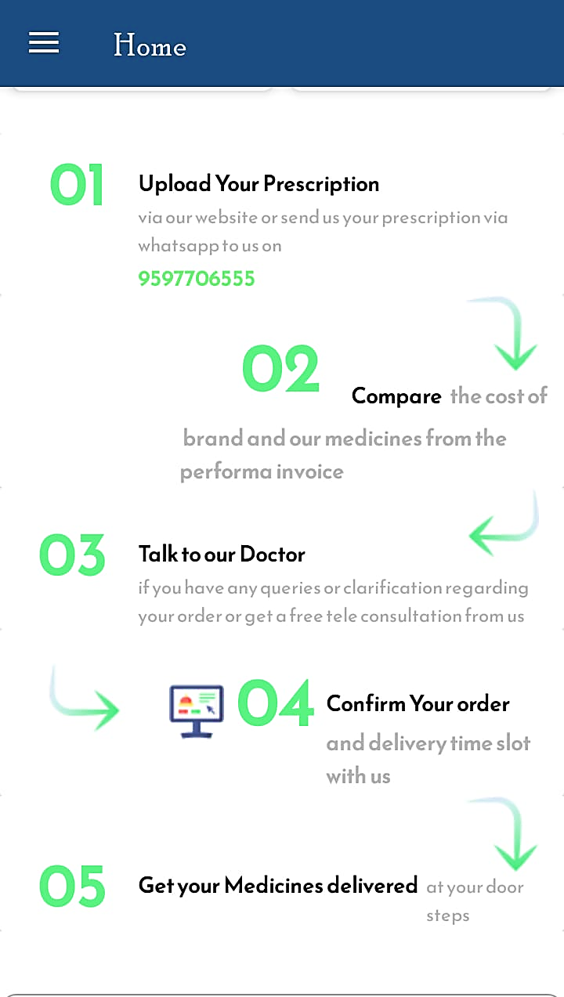

8 & 9

Slide 18

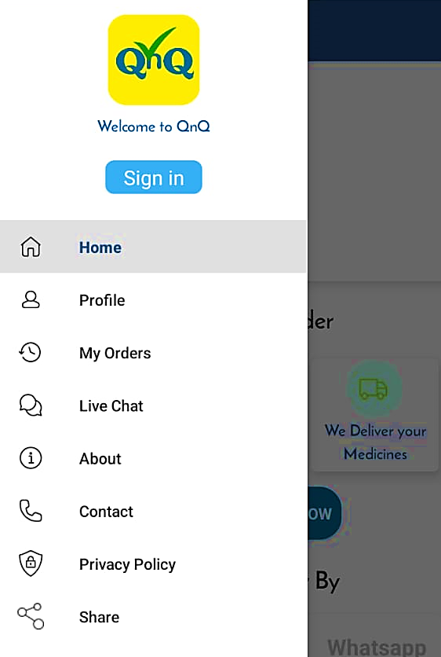
5. MENU
1. Navigate the menu bar; it shows options like "Home," "Profile," "My Orders," "About," "Contact," etc.

Slide 19

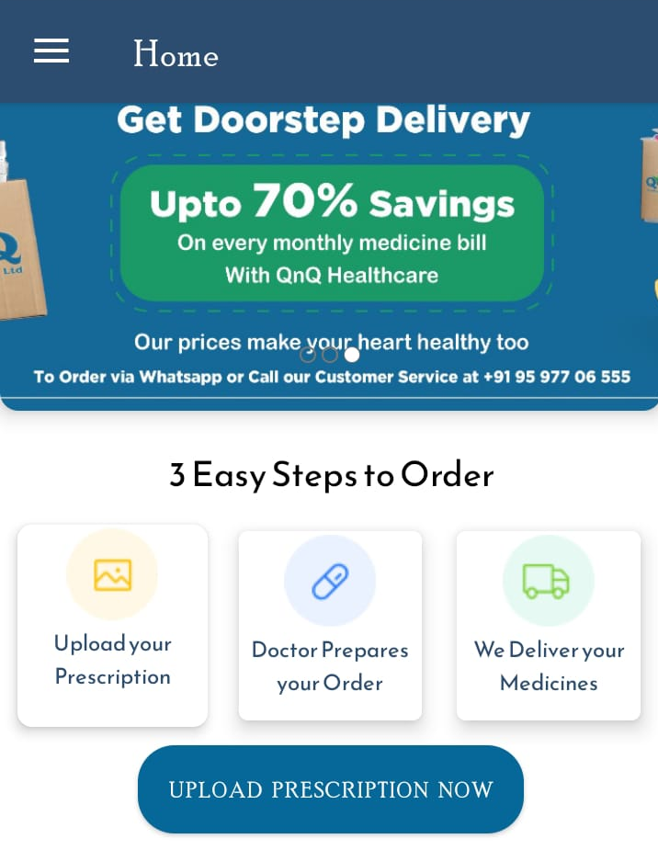
5. MENU
Home:
The 'HOME' menu displays "Prescription Uploads," "Instructions," and "FAQ."

Slide 20
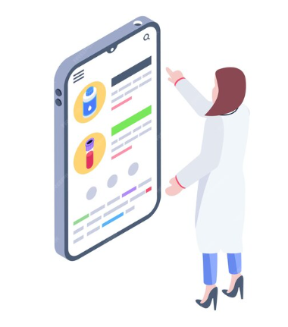
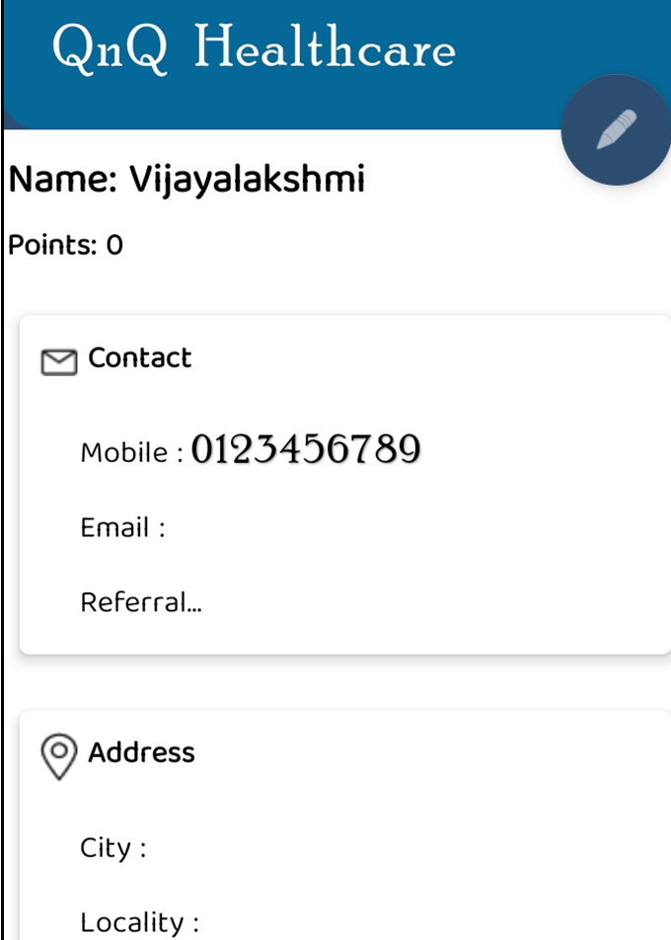
5. MENU
Profile:
The profile shows your sign-in details.

Slide 21

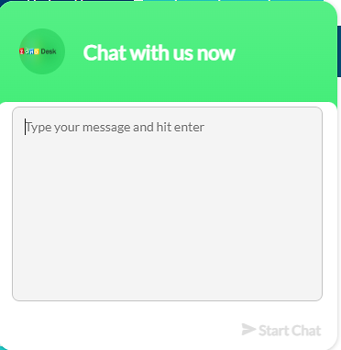
5. MENU
My Orders:
"My Order" appears for customers with orders, managed by the "Call Centre" to display details from the previous and current days, including delivery status and invoices.
Live chat:
1. "Live chat" is displayed if you want to place an order through live chat.

Slide 22

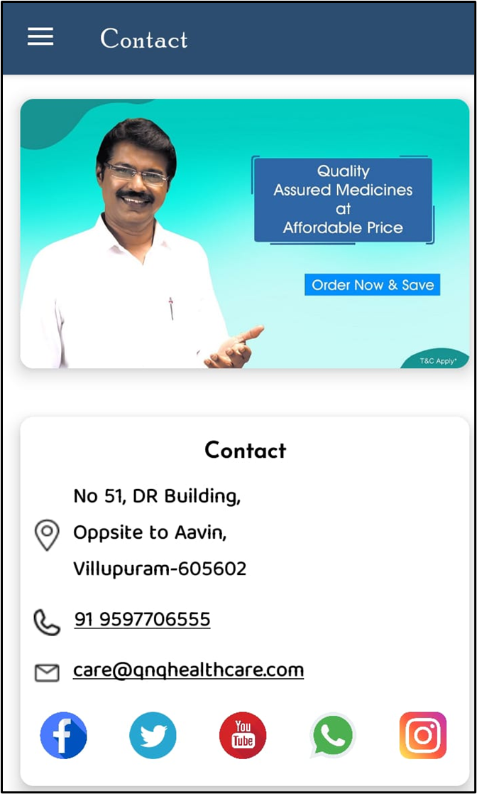
5. MENU
About:
1. 'About' displays information about "QnQ HEALTHCARE," including our "VISION AND MISSION."
Contact:
'CONTACT' displays our contact number and address.

Slide 23

THANK YOU

